Slide 1
Mediator Design Pattern
Tejas Waydande

Slide 2
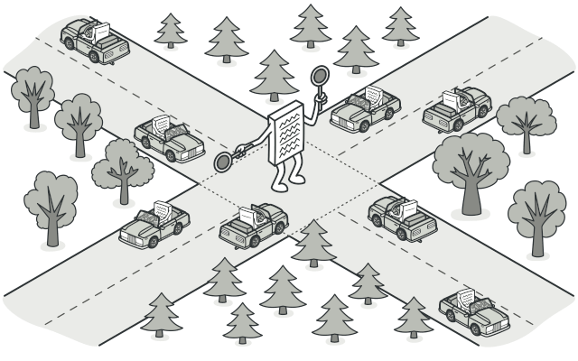
What is Mediator?
Mediator is a behavioral design pattern that lets you reduce chaotic dependencies between objects. The pattern restricts direct communications between the objects and forces them to collaborate only via a mediator object.

Slide 3
Components of the Mediator Design Pattern:
Mediator: Defines the communication interface to coordinate interactions between objects, centralizing control and promoting loose coupling.
Colleague: Components that interact only through the Mediator, ensuring isolation and flexibility.
Concrete Mediator: Implements the Mediator, managing and coordinating interactions among specific colleagues.
Concrete Colleague: Specific implementations of Colleague, relying on the Mediator for communication, avoiding direct dependencies.

Slide 4
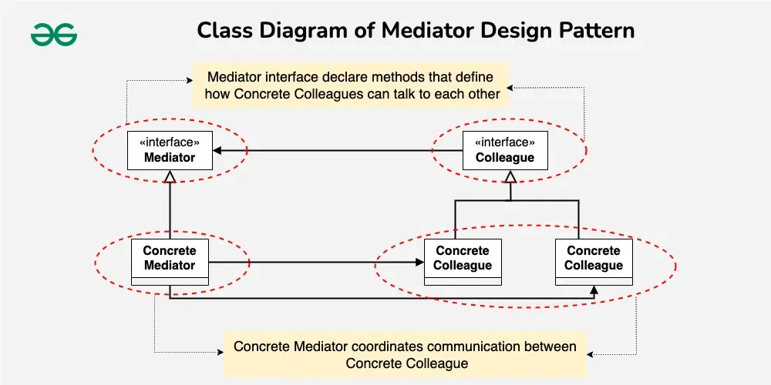
How components are interacting with each other ?
A Concrete Colleague object sends a message or notification to the Concrete Mediator when it needs to communicate with another colleague.
The Concrete Mediator receives the message and determines how to coordinate the interaction between the specific Concrete Colleague objects involved.
The Concrete Mediator may then invoke methods on the Concrete Colleague objects to facilitate their communication.
Colleague objects interact indirectly through the Concrete Mediator, maintaining loose coupling and avoiding direct dependencies.

Slide 5
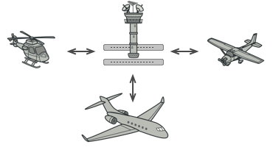
Real-World Analogy:
Aircraft pilots don’t talk to each other directly when deciding who gets to land their plane next. All communication goes through the control tower.
The air traffic control tower acts as a mediator, facilitating communication between airplanes. This ensures that all airplanes are aware of each other’s positions and intentions.

Slide 6
When to use the Mediator Design Pattern?
Complex Communication: Your system involves a set of objects that need to communicate with each other in a complex manner, and you want to avoid direct dependencies between them.
Loose Coupling: You want to promote loose coupling between objects, allowing them to interact without knowing the details of each other’s implementations.
Centralized Control: You need a centralized mechanism to coordinate and control the interactions between objects, ensuring a more organized and maintainable system.
Changes in Behavior: You anticipate changes in the behavior of components, and you want to encapsulate these changes within the mediator, preventing widespread modifications.
Enhanced Reusability: You want to reuse individual components in different contexts without altering their internal logic or communication patterns.

Slide 7
Cons:
Pros :
Single Responsibility Principle. You can extract the communications between various components into a single place, making it easier to comprehend and maintain.
Open/Closed Principle. You can introduce new mediators without having to change the actual components.
You can reduce coupling between various components of a program.
You can reuse individual components more easily.
Over time a mediator can evolve into a God Object.

Slide 8




THANK YOU
(844) 720-6678
info@simplifyhealthcare.com
simplifyhealthcare.com
Simplify Healthcare
U.S.: 600 N Commons Drive, Suite 110, Aurora, IL 60504
India: 401/402, 4th Floor, Pentagon P-2, Magarpatta City, Pune 411013
CONNECT WITH US
LinkedIn
YouTube
X
Instagram

